Slide 1
Helping the Homeless with QCare Qiosk
Developed By Hailey Hultquist, Takondwa Kakusa, James Shao, and Cameron West

Slide 2
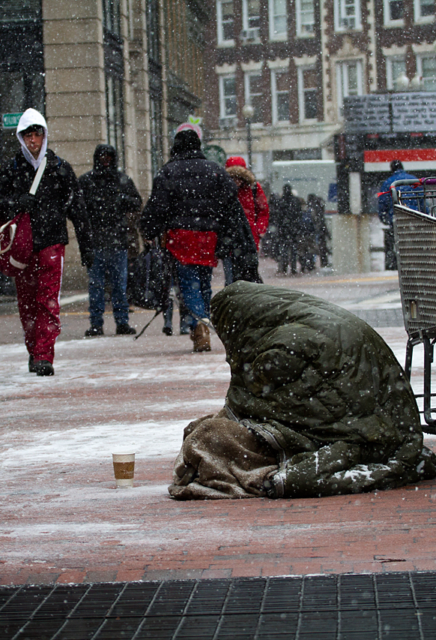
Statistics on the Homeless Population.
In 2016, there were 550,000 Americans that were homeless
Los Angeles and San Diego have the 2nd and 4th highest homeless populations in the nation.
California accounts for 28% of all homeless population
Homeless is caused by the lack of funds and a severe lack of affordable housing

Slide 3
What We Aim To Do.
The goal is to:
Provide easy access to technology in locations where use of technology is limited or discouraged.
Provide a service to be able to easily put the homeless and underserved into contact with employers needing low-skilled labor.
Provide a service to be able to help the individual save to be able to afford adequate housing.
Create an easy-to-use interface with large buttons and text-to-speech functionality with support for multiple languages for the illiterate and non-English speakers

Slide 4
References
https://www.nlchp.org/documents/Homeless_Stats_Fact_Sheet
https://www.forbes.com/sites/niallmccarthy/2016/11/25/the-u-s-cities-where-the-largest-homeless-pop-infographic/#1dc344c24dde
http://host.madison.com/wsj/news/special/homeless/introducing-the-series-a-challenge-to-move-beyond-stereotypes-and/article_372866d7-3bb9-5690-87e2-1c98b8f58995.html

